Slide 1
Introduction of Generative Adversarial Network (GAN)

Slide 2
Discriminative Model
SVM, Logistic Regression, Random Forests…
Notes:
SVM 决策树 逻辑回归 DNN 都属于判别模型，目标是学得不同类别之间的最优分类面，反映的是异类数据之间的差异，对于数据本身的特征不关注
判别模型 条件概率
生成模型 联合概率

Slide 3
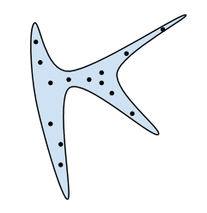
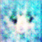


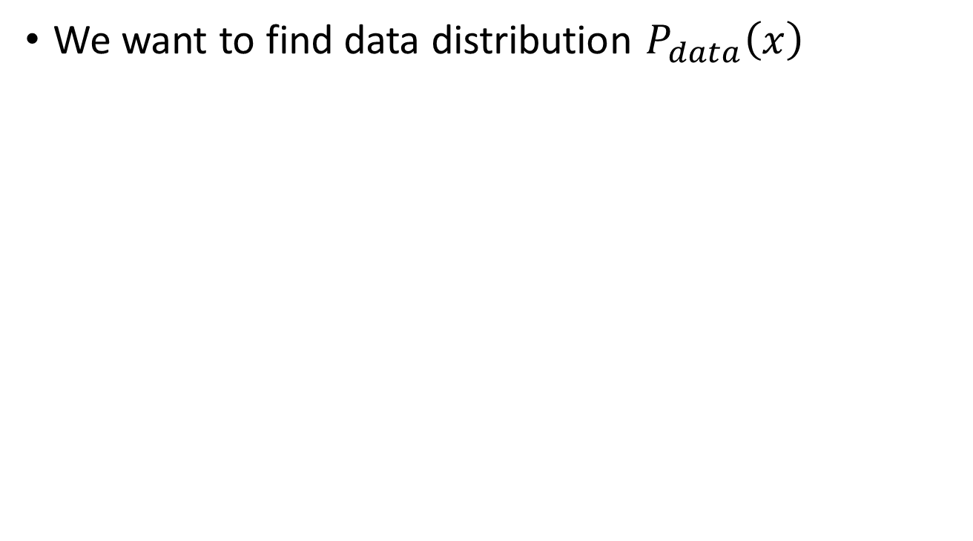

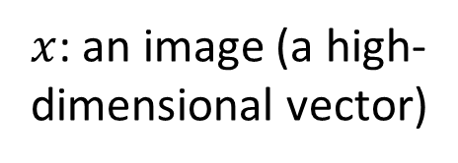
Generation
$x$: an image (a high-dimensional vector)
We want to find data distribution $P_{data}\left(x\right)$
$$P_{data}\left(x\right)$$
High
Probability
Image
Space
Low
Probability
Notes:
图片——高维空间中的一个点
寻找高维空间中的一个分布函数，使得点落在蓝色区域的概率较大，落在其他区域的概率较小。那么这个分布函数就可以刻画出图片为二次元人物头像的可能性。

Slide 4
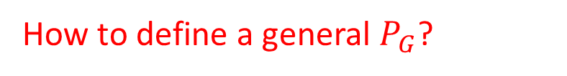
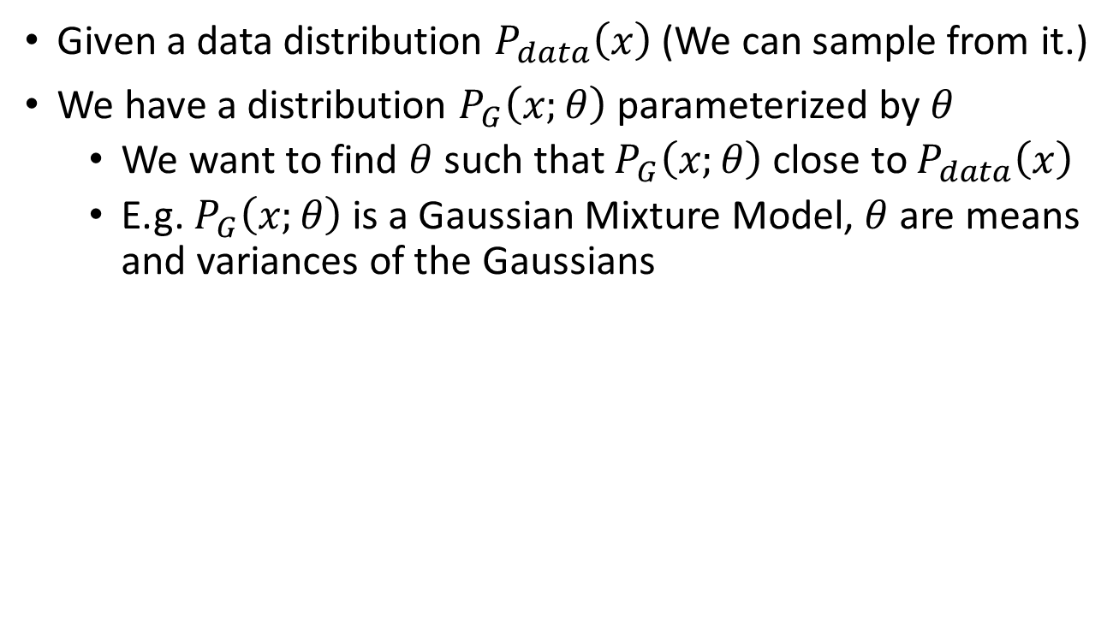
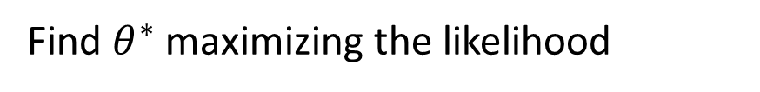
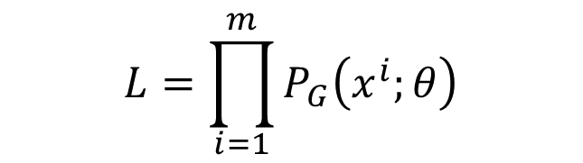
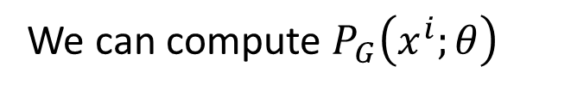
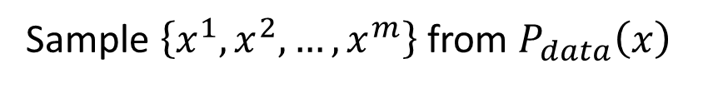
Maximum Likelihood Estimation
Given a data distribution $P_{data}\left(x\right)$ (We can sample from it.)
We have a distribution $P_{G}\left(x;θ\right)$parameterized by $θ$
We want to find $θ$such that $P_{G}\left(x;θ\right)$close to $P_{data}\left(x\right)$
E.g. $P_{G}\left(x;θ\right)$is a Gaussian Mixture Model, $θ$are means and variances of the Gaussians
Sample $\left\{x^{1},x^{2},…,x^{m}\right\}$ from $P_{data}\left(x\right)$
We can compute $P_{G}\left(x^{i};θ\right)$
Likelihood of generating the samples
$$L=\prod_{i=1}^{m}{P_{G}\left(x^{i};θ\right)}$$
Find $θ^{∗}$maximizing the likelihood
How to define a general $P_{G}$?
Notes:
假设 服从参数为$θ的$分布P_{G}
理论上GMM可以拟合出任意类型的分布

Slide 5




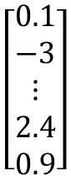
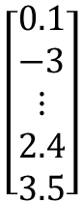
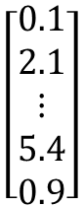
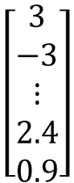
Basic Idea of GAN
Powered by: http://mattya.github.io/chainer-DCGAN/
It is a neural network (NN), or a function.
Generator
high dimensional vector
image
vector
$$\left[\begin{aligned}0.1 \\ −3 \\ ⋮ \\ 2.4 \\ 0.9\end{aligned}\right]$$
$$\left[\begin{aligned}3 \\ −3 \\ ⋮ \\ 2.4 \\ 0.9\end{aligned}\right]$$
Generator
Generator
Each dimension of input vector represents some characteristics.
Longer hair
$$\left[\begin{aligned}0.1 \\ 2.1 \\ ⋮ \\ 5.4 \\ 0.9\end{aligned}\right]$$
$$\left[\begin{aligned}0.1 \\ −3 \\ ⋮ \\ 2.4 \\ 3.5\end{aligned}\right]$$
Generator
Generator
blue hair
Open mouth
Notes:
二次元人物头像生成

Slide 6

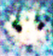
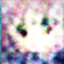
Basic Idea of GAN
It is a neural network (NN), or a function.
Discri-minator
scalar
image
Larger value means real, smaller value means fake.
Discri-minator
Discri-minator
1.0
1.0
Discri-minator
Discri-minator
0.1
0.1

Slide 7
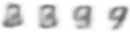
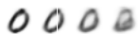
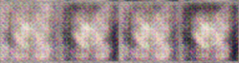
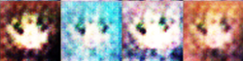
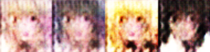


Basic Idea of GAN
This is where the term “adversarial” comes from.
NN
Generator
v1
NN
Generator
v2
NN
Generator
v3
Discri-minator
v1
Discri-minator
v2
Discri-minator
v3
Real images:
Notes:
Binary
Classifier

Slide 8

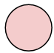
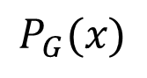
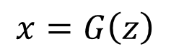
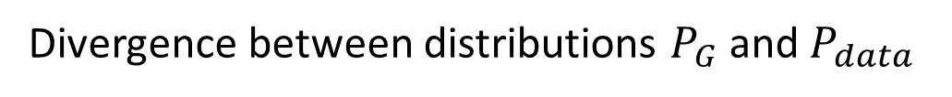
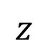
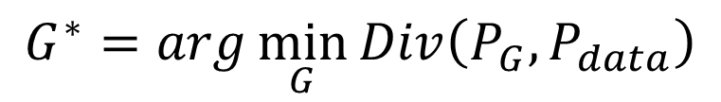
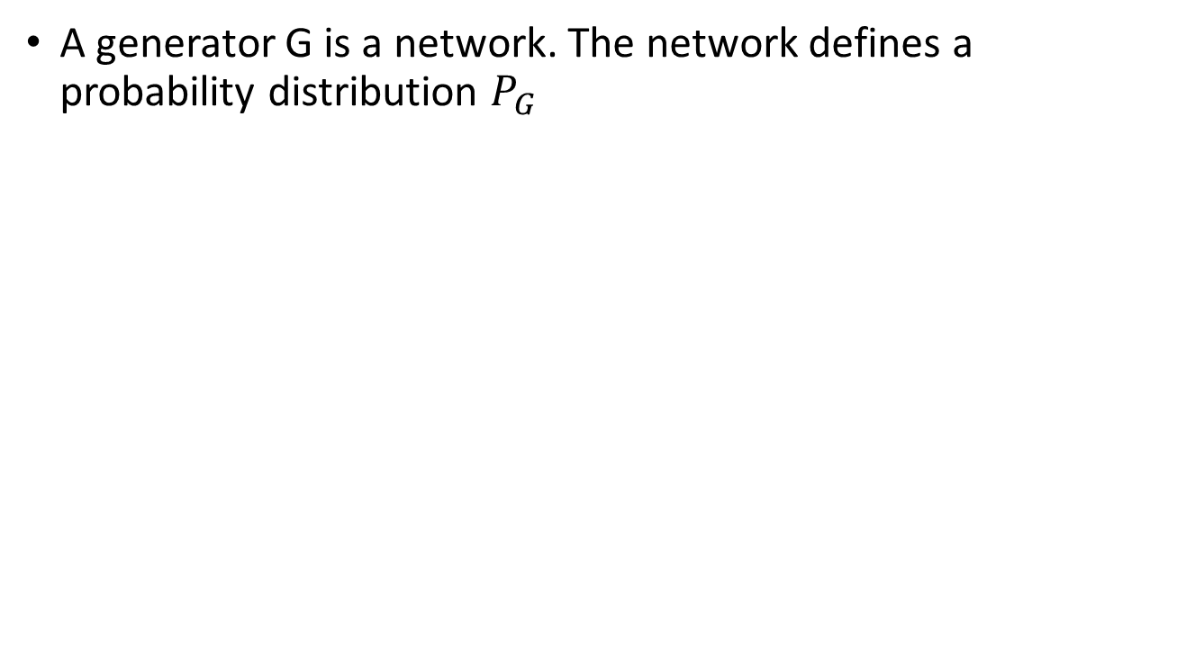

Generator
$x$: an image (a high-dimensional vector)
A generator G is a network. The network defines a probability distribution $P_{G}$
$$P_{G}\text{(}\text{x}\text{)}$$
$$P_{data}\left(x\right)$$
Normal Distribution
generator
G
$$z$$
$$x=G\left(z\right)$$
as close as possible
$$G^{∗}=arg\min_{G}{Div\left(P_{G},P_{data}\right)}$$
Divergence between distributions $P_{G}$and $P_{data}$
How to compute the divergence?

Slide 9






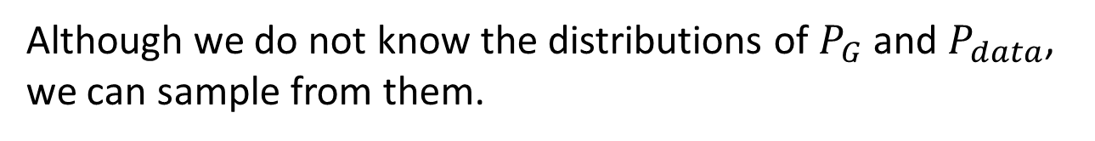
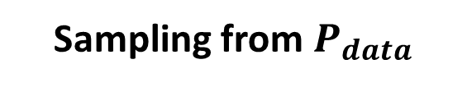
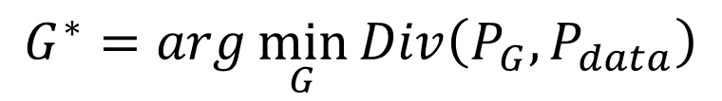
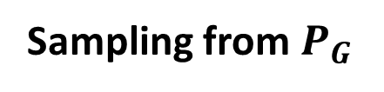
Discriminator
$$G^{∗}=arg\min_{G}{Div\left(P_{G},P_{data}\right)}$$
Although we do not know the distributions of $P_{G}$and $P_{data}$, we can sample from them.
sample
Database
Sampling from $P_{data}$
sample from normal
G
vector
vector
vector
vector
Sampling from $P_{G}$

Slide 10
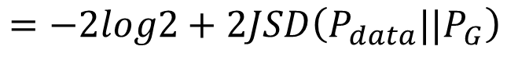
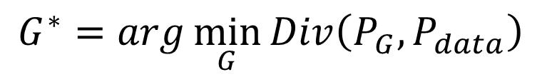
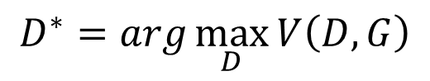
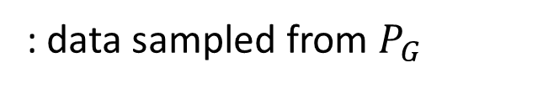
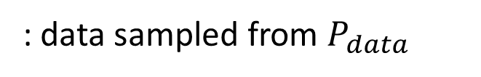
Discriminator
$$G^{∗}=arg\min_{G}{Div\left(P_{G},P_{data}\right)}$$
: data sampled from $P_{data}$
Using the example objective function is exactly the same as training a binary classifier.
: data sampled from $P_{G}$
Discriminator
train
Sigmoid Output
Example Objective Function for D
$$V\left(G,D\right)=E_{x∼P_{data}}\left[logD\left(x\right)\right]+E_{x∼P_{G}}\left[log\left(1−D\left(x\right)\right)\right]$$
(G is fixed)
Training:
$$D^{∗}=arg\max_{D}{V\left(D,G\right)}$$
$$=−2log2+2JSD\left(P_{data}||P_{G}\right)$$
Jensen-Shannon divergence
[Goodfellow, et al., NIPS, 2014]
Notes:
为什么要用这种形式的V(G,D) 因为V(G,D)取最大值时，数学推导出来的形式就是JS散度

Slide 11
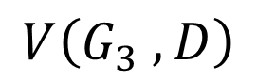
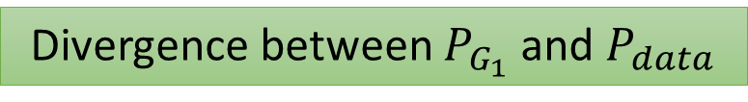
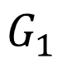
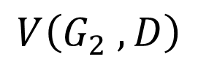
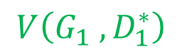
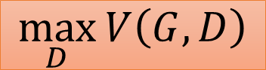
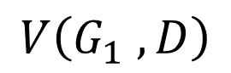
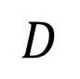
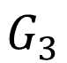
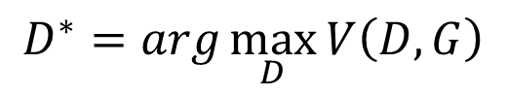
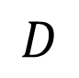
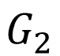
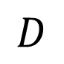

$$G^{∗}=arg\min_{G}{Div\left(P_{G},P_{data}\right)}$$
$$\max_{D}{V\left(G,D\right)}$$
$$D^{∗}=arg\max_{D}{V\left(D,G\right)}$$
The maximum objective value is related to JS divergence.
$$V\left(G_{1} ,D\right)$$
$$V\left(G_{2} ,D\right)$$
$$V\left(G_{3} ,D\right)$$
$$V\left(G_{1} ,D_{1}^{∗}\right)$$
$$D$$
$$D$$
$$D$$
$$G_{1}$$
$$G_{2}$$
$$G_{3}$$
Divergence between $P_{G_{1}}$and $P_{data}$
Notes:
使用maxV(G,D)来刻画两个数据分布之间的差距

Slide 12
$$G^{∗}=arg\min_{G}{Div\left(P_{G},P_{data}\right)}$$
$$\max_{D}{V\left(G,D\right)}$$
$$D^{∗}=arg\max_{D}{V\left(D,G\right)}$$
The maximum objective value is related to JS divergence.
Initialize generator and discriminator
In each training iteration:
Step 1: Fix generator G, and update discriminator D
Step 2: Fix discriminator D, and update generator G

Slide 13


Initialize $θ_{d}$ for D and $θ_{g}$for G
Algorithm
In each training iteration:
Sample m examples $\left\{x^{1},x^{2},…,x^{m}\right\}$ from data distribution $P_{data}\left(x\right)$
Sample m noise samples $\left\{z^{1},z^{2},…,z^{m}\right\}$ from the prior $P_{prior}\left(z\right)$
Obtaining generated data $\left\{{\tilde{x}}^{1},{\tilde{x}}^{2},…,{\tilde{x}}^{m}\right\}$, ${\tilde{x}}^{i}=G\left(z^{i}\right)$
Update discriminator parameters $θ_{d}$ to maximize
$\tilde{V}=\frac{1}{m}\sum_{i=1}^{m}{logD\left(x^{i}\right)}+\frac{1}{m}\sum_{i=1}^{m}{log\left(1−D\left({\tilde{x}}^{i}\right)\right)}$
$θ_{d}←θ_{d}+η∇\tilde{V}\left(θ_{d}\right)$
Sample another m noise samples $\left\{z^{1},z^{2},…,z^{m}\right\}$ from the prior $P_{prior}\left(z\right)$
Update generator parameters $θ_{g}$ to minimize
$\tilde{V}=\frac{1}{m}\sum_{i=1}^{m}{logD\left(x^{i}\right)}+\frac{1}{m}\sum_{i=1}^{m}{log\left(1−D\left(G\left(z^{i}\right)\right)\right)}$
$θ_{g}←θ_{g}−η∇\tilde{V}\left(θ_{g}\right)$
Learning
D
Step 1
Repeat k times
Learning
G
Step 2
Only Once

Slide 14



Application
Notes:
目前, 图像和视觉领域是对 GAN 研究和应用最广泛的一个领域，已经可以生成数字、人脸等物体对象，构成各种逼真的室内外场景, 从分割图像恢复原图像, 给黑白图像上色, 从物体轮廓恢复物体图像, 从低分辨率图像生成高分辨率图像等。

Slide 15

Anime Face Generation
100 updates
Source of training data: https://zhuanlan.zhihu.com/p/24767059

Slide 16

Anime Face Generation
1000 updates

Slide 17

Anime Face Generation
2000 updates

Slide 18

Anime Face Generation
5000 updates

Slide 19

Anime Face Generation
10,000 updates

Slide 20

Anime Face Generation
20,000 updates

Slide 21

Anime Face Generation
50,000 updates

